Slide 1
Finding the original amount after a decrease
Understanding multiplicative relationships: percentages and proportionality

Slide 2
how to use Oak lessons

Slide 3
I can calculate the original value, given the final value after a stated percentage decrease.

Slide 4
The reciprocal is the multiplicative inverse of any non-zero number. Any non-zero number multiplied by its reciprocal is equal to 1.

Slide 5

Finding the original amount after a decrease
Finding the original value
Using a multiplier
Mixed reverse percentage problems

Slide 6
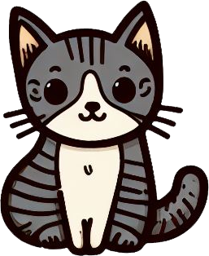
Finding the original value
Alex’s cat goes to the vet once a year.
The vet tells Alex that his cat has lost 30% of its mass.
His cat now has a mass of 4.2 kg.
What was the mass of Alex’s cat last year?
new mass
4.2 kg ÷ 7 = 0.6 kg
mass lost
0.6 | 0.6 | 0.6 | 0.6 | 0.6 | 0.6 | 0.6
0.6 | 0.6 | 0.6 | 0.6 | 0.6 | 0.6 | 0.6 | 0.6 | 0.6 | 0.6
0.6 kg × 10 = 6 kg
original mass
Alex’s cat had a mass of 6 kg last year.

Slide 7
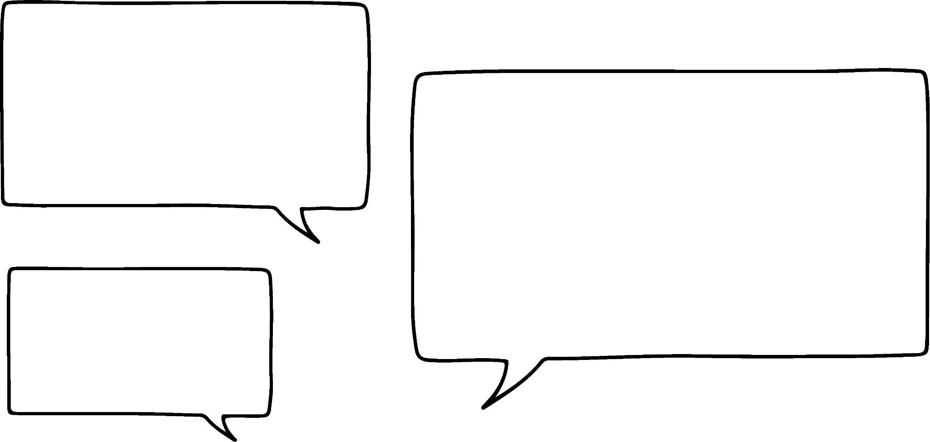


Finding the original value
I’ve just bought a hoodie for £41.25 but that was when the shop had a 25% sale that has finished now.
We can work out how much it will cost me to buy the hoodie now.
Lucas
Sofia
sale price
£41.25 ÷ 3 = £13.75
amount saved
£13.75 | £13.75 | £13.75 | £13.75
£13.75 | £13.75 | £13.75
original price
£13.75 × 4 = £55
Lucas needs £55 to buy the hoodie.

Slide 8

Finding the original value
We can also solve this type of problem with a double number line. This is more useful when the bar cannot be easily partitioned to show the percentage.
The cost of a car depreciates by 16% in the first year.
The car is now worth £12 600
How much did the car cost when it was first purchased?
What percentage of the original cost is the car now worth?
100% − 16% = 84%

Slide 9
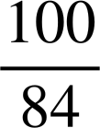
Finding the original value
The cost of a car depreciates by 16% in the first year.
The car is now worth £12 600
How much did the car cost when it was first purchased?
It is now worth 84% of the original cost.
×
84
100
%
The original cost of the car was £15 000
cost
12 600
15 000
×

Slide 10
Finding the original value
A reduced sugar chocolate bar contains 30% less sugar than the regular bar.
The reduced sugar bar contains 36.8 grams of sugar.
How much sugar is in the regular bar?
% | grams
 | 36.8
% | grams
70 | 36.8
What percentage is equivalent to 36.8 g?

Slide 11
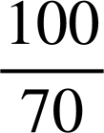
Finding the original value
A reduced sugar chocolate bar contains 30% less sugar than the regular bar.
The reduced sugar bar contains 36.8 grams of sugar.
How much sugar is in the regular bar?
% | grams
70 | 36.8
100
% | grams
70 | 36.8
100 | 52.6
×
×
The regular bar of chocolate contains 52.6 g (1 d.p.).

Slide 12
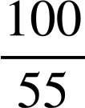
Finding the original value
Using any of the 3 different methods, answer this question.
A low salt packet of crisps contains 0.17 g of salt.
The packet contains 45% less salt than the regular bags.
How much salt is in a regular bag?
% | grams
55 | 0.17
100 | 0.31
% | grams
55 | 0.17
100
×
×
The regular bag of crisps contains 0.31 g (2 d.p.).

Slide 13

Finding the original value
Using your preferred method, answer the following. Give your answers to an appropriate degree of accuracy.
A t-shirt costs £21 in a sale offering a 25% discount. What is the cost of the t-shirt before the discount?

Slide 14

Finding the original value
Using your preferred method, answer the following. Give your answers to an appropriate degree of accuracy.
b) A car's value depreciates by 22% in the first year. It is now worth £11 544. What was the cost of the car originally?

Slide 15
Finding the original value
Using your preferred method, answer the following. Give your answers to an appropriate degree of accuracy.
c) A packet of crisps contains 33% less fat. This low fat packet contains 5.3 g of fat. How much fat is in a regular packet?

Slide 16
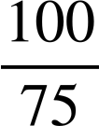
Finding the original value
Using your preferred method, answer the following. Give your answers to an appropriate degree of accuracy.
A t-shirt costs £21 in a sale offering a 25% discount. What is the cost of the t-shirt before the discount?
% | price (£)
75 | 21
100 | 28
×
×
The price of the t-shirt before the discount is £28

Slide 17
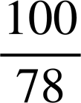
Finding the original value
Using your preferred method, answer the following. Give your answers to an appropriate degree of accuracy.
b) A car's value depreciates by 22% in the first year. It is now worth £11 544. What was the cost of the car originally?
% | cost (£)
78 | 11 544
100 | 14 800
×
×
The cost of the car was originally £14 800

Slide 18
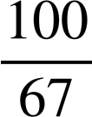
Finding the original value
Using your preferred method answer the following. Give your answers to an appropriate degree of accuracy.
c) A packet of crisps contains 33% less fat. This low fat packet contains 5.3 g of fat. How much fat is in a regular packet?
% | grams
67 | 5.3
100 | 7.9
×
×
The regular packet contains 7.9 g of fat.

Slide 19
Finding the original amount after a decrease
Finding the original value
Using a multiplier
Mixed reverse percentage problems

Slide 20


Using a multiplier
Aisha buys her cinema ticket online. This saves her 6% of the usual cost of the ticket.
I’d like to go with you Aisha but I cannot get my ticket online. How much will my ticket cost?
My ticket cost £7.05
94% of c = £7.05
Aisha
‘of’ can be exchanged for multiplication
Jacob
What percentage of the usual ticket price does Aisha pay?
100% − 6% = 94%
94% × c = £7.05
convert to a multiplier in decimal form
0.94 × c = £7.05
c = £7.05 ÷ 0.94
c = £7.50
The usual ticket costs £7.50

Slide 21
Using a multiplier
Spot the mistakes.
An online store sells a TV for £393.60. This is 18% lower than a shop on the high street.
How much does the TV cost on the high street?
100% − 18%
18% of c = £393.60
82%
18% ÷ c = £393.60
82%
×
0.82
0.18 ÷ c = £393.60
×
÷
c = £393.60 × 0.18
c = £393.60
0.82
£480

Slide 22
Using a multiplier
Given the new amount and percentage decrease find the original amount. All of the answers are in the grid except for one.
Write a percentage question that gives this answer.
 | Percentage Decrease | New Amount
a | 10% | 315
b | 15% | 289
c | 45% | 176
d | 12% | 306.24
e | 36% | 245.76
f | 80% | 73.6
g | 12.5% | 288.75
h | 3.6% | 303.66
i
320 | 384 | 340
315 | 325 | 350
368 | 330 | 348

Slide 23
Using a multiplier
Given the new amount and percentage decrease find the original amount. All of the answers are in the grid except for one.
Write a percentage question that gives this answer.
 | Percentage Decrease | New Amount
a | 10% | 315
b | 15% | 289
c | 45% | 176
d | 12% | 306.24
e | 36% | 245.76
f | 80% | 73.6
g | 12.5% | 288.75
h | 3.6% | 303.66
i | E.g. 35% | 211.25
320 | 384 | 340
315 | 325 | 350
368 | 330 | 348
c
e
b
h
a
f
g
d

Slide 24
Finding the original amount after a decrease
Finding the original value
Using a multiplier
Mixed reverse percentage problems

Slide 25
Mixed reverse percentage problems
Reverse percentage problems are problems where you know the new value and need to find the original value.
E.g. A special offer box of cereal contains 375 grams. This is 25% more than the usual box. How heavy is the usual box?
Izzy buys a bag from a shop advertising a 10% sale. She pays £22.50 for the bag. What is the cost of the bag before the sale?

Slide 26


Mixed reverse percentage problems
There are 72 apples in this special offer box.
How many apples are in the normal box?
20% extra free
Izzy’s workings
100% − 20% = 80%
72 ÷ 0.8 = 90 apples
Are Izzy’s calculations correct?
No, Izzy has subtracted 20% from 100%, she should have added it as the box contains an extra 20%.
How could Izzy have known her answer was incorrect?
The number of apples in the normal box was more than the special offer box!

Slide 27
Mixed reverse percentage problems
There are 72 apples in this special offer box.
How many apples are in the normal box?
20% extra free
We know the number of apples in the special offer box.
Usual box + extra free = 72 apples
100% + 20% = 72 apples
120% of a = 72 apples
1.2 × a = 72 apples
a = 72 ÷ 1.2
a = 60 apples
The box usually contains 60 apples.

Slide 28
Mixed reverse percentage problems
For each of the following we will decide if you need to subtract the percentage from 100% or add the percentage onto 100%.
The height of a sunflower increases by 10% over a week and now measures 1.2 m. How tall was the sunflower last week?
100% + 10%

Slide 29
Mixed reverse percentage problems
For each of the following we will decide if you need to subtract the percentage from 100% or add the percentage onto 100%.
The water level in a pond drops by 5%. The level is currently 45 cm. What was the level before the drop?
100% − 5%

Slide 30
Mixed reverse percentage problems
For each of the following we will decide if you need to subtract the percentage from 100% or add the percentage onto 100%.
A puppy gains 8% of its birth mass over the first 3 months. It nows weighs 6 kg. How much did it weigh at birth?
100% + 8%

Slide 31


Mixed reverse percentage problems
The cost of a camera increases by 15% to £276.
What was the cost of the camera originally?
Which is the correct ratio table to match this problem?
% | Cost (£)
15 | 276
100
% | Cost (£)
115 | 276
100
% | Cost (£)
85 | 276
100
This represents £276 being equal to 15%.
This represents £276 being equal to 85%, therefore a 15% decrease.

Slide 32
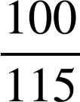
Mixed reverse percentage problems
The cost of a camera increases by 15% to £276.
What was the cost of the camera originally?
% | Cost (£)
115 | 276
100
×
×
240
The camera originally cost £240

Slide 33
Mixed reverse percentage problems
Keywords in questions:
A shop offers a discount for bulk buys of 5%.
A bank gives 2.3% interest on a savings account.
A house is sold at a loss of 12%.
The value of a caravan depreciates by 15% over a year.
A special offer bag of sweets contains an extra 12%.
An antique clock is sold for a profit of 52%.

Slide 34
Mixed reverse percentage problems
We will now sort these into whether they are increase or decrease problems:
discount
interest
loss
depreciates
extra
profit
DECREASE
INCREASE
discount
interest
loss
extra
depreciates
profit

Slide 35
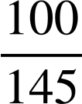
Mixed reverse percentage problems
Spot and correct the mistake.
Sam’s aunt buys a vase and sells it for a profit of 45%.
She sells it for £232.
How much did she pay for it?
% | Cost (£)
55 | 232
100 | 412.82
145
×
×
160
Sam’s aunt paid £160 for the vase.

Slide 36
Mixed reverse percentage problems
Decide whether each of the following questions indicate a decrease or increase question.
A watch is sold for £46.80, this was a loss of 35%.
A bag of apples contains an extra 25% free. The bag contains 20 apples.
The value of a motorbike depreciates by 20%. It is now worth £6820
A savings account earns 2.2% interest. The account now contains £613.20
You buy a laptop for £244.40, this price has been discounted by 6%.

Slide 37
Mixed reverse percentage problems
2) Using your preferred method, find the original amounts in the following questions.
A watch is sold for £46.80. This was a loss of 35%.
A bag of apples contains an extra 25% free. The bag contains 20 apples.
The value of a motorbike depreciates by 20%. It is now worth £6820
A savings account earns 2.2% interest. The account now contains £613.20
You buy a laptop for £244.40. This price has been discounted by 6%.

Slide 38
Mixed reverse percentage problems
Decide whether each of the following questions indicate a decrease or increase question.
A watch is sold for £46.80, this was a loss of 35%.
A bag of apples contains an extra 25% free. The bag contains 20 apples.
The value of a motorbike depreciates by 20%. It is now worth £6820
A savings account earns 2.2% interest. The account now contains £613.20
You buy a laptop for £244.40, this price has been discounted by 6%.
decrease
increase
decrease
increase
decrease

Slide 39
Mixed reverse percentage problems
2) Using your preferred method, find the original amounts in the following questions.
A watch is sold for £46.80. This was a loss of 35%.
46.80 ÷ 0.65 = £72
A bag of apples contains an extra 25% free. The bag contains 20 apples.
20 ÷ 1.25 = 16 apples

Slide 40
Mixed reverse percentage problems
2) Using your preferred method, find the original amounts in the following questions.
c) The value of a motorbike depreciates by 20%. It is now worth £6820
6820 ÷ 0.8 = £8525
d) A savings account earns 2.2% interest. The account now contains £613.20
613.20 ÷ 1.022 = £600

Slide 41
Mixed reverse percentage problems
2) Using your preferred method, find the original amounts in the following questions.
e) You buy a laptop for £244.40. This price has been discounted by 6%.
244.40 ÷ 0.94 = £260

Slide 42
Finding the original amount after a decrease
Bar models, double number lines, ratio tables and multipliers can be used to find the original amount.
‘Of’ can be exchanged for multiplication in maths problems.
A ‘multiplier’ is the decimal equivalent of a percentage.
Keywords such as discount, loss and depreciation usually indicate a decrease.
Keywords such as profit, extra and interest usually indicate an increase.
It is important to fully understand the context when determining the correct approach.

Slide 43

© Oak National Academy 2024.
Produced in partnership with Mathematics in Education and Industry.
Licensed on the Open Government Licence v3.0, except where otherwise stated. See Oak terms and conditions.

